Slide 1
Graph Algorithms
Design and Analysis of Algorithms

Slide 2
Minimum Spanning Tree
Kruskal's algorithm
Prim's algorithm

Slide 3
Minimum Spanning Trees
Let G=(V,E) be a connected, undirected graph.
For each edge (u,v) in E, we have a weight w(u,v) specifying the cost (length of edge) to connect u and v.
We wish to find a (acyclic) subset T of E that connects all of the vertices in V and whose total weight is minimized.
Since the total weight is minimized, the subset T must be acyclic (no circuit).
Thus, T is a tree. We call it a spanning tree.
The problem of determining the tree T is called the minimum-spanning-tree problem.

Slide 4
Applications of MST
In the design of electronic circuitry, it is often necessary to make a set of pins electrically equivalent by wiring them together.
To interconnect n pins, we can use n-1 wires, each connecting two pins.
We want to minimize the total length of the wires.
Minimum Spanning Trees can be used to model this problem.

Slide 5
Examples of MST
Example:
6
c
6
c
c
a
a
a
4
1
4
1
1
2
2
d
d
d
b
3
b
b
3

Slide 6
MST Algorithm
Set A is always a subset of some minimum spanning tree. This property is called the invariant Property.
An edge (u,v) is a safe edge for A if adding the edge to A does not destroy the invariant.
A safe edge is just the CORRECT edge to choose to add to T.
GENERIC_MST(G,w)
1 A:={}
2 while A does not form a spanning tree do
3 find an edge (u,v) that is safe for A
4 A:=A∪{(u,v)}
5 return A

Slide 7
Kruskal's algorithm(basic part)
(Sort the edges in an increasing order)
A:={}
while E is not empty do {
take an edge (u, v) that is shortest in E
and delete it from E
if u and v are in different components then
add (u, v) to A
}
Note: each time a shortest edge in E is considered.

Slide 8
Kruskal's algorithm (Fun Part, not required)
MST_KRUSKAL(G,w)
1 A:={}
2 for each vertex v in V[G]
3 do MAKE_SET(v)
4 sort the edges of E by nondecreasing weight w
5 for each edge (u,v) in E, in order by nondecreasing weight
6 do if FIND_SET(u) != FIND_SET(v)
7 then A:=A∪{(u,v)}
8 UNION(u,v)
return A
(Disjoint set is discussed in Chapter 21, Page 498)

Slide 9
The edges are considered by the algorithm in sorted order by weight.
The edge under consideration at each step is shown with a red weight number.
8
7
b
c
d
9
4
2
a
11
i
14
e
4
7
6
8
10
h
g
f
1
2

Slide 10
8
7
b
c
d
9
4
2
a
11
i
14
e
4
7
6
8
10
h
g
f
1
2
8
7
b
c
d
9
4
2
a
11
i
14
e
4
7
6
8
10
h
g
f
1
2

Slide 11
8
7
b
c
d
9
4
2
a
11
i
14
e
4
7
6
8
10
h
g
f
1
2
8
7
b
c
d
9
4
2
a
11
i
14
e
4
7
6
8
10
h
g
f
1
2

Slide 12
8
7
b
c
d
9
4
2
a
11
i
14
e
4
7
6
8
10
h
g
f
1
2
8
7
b
c
d
9
4
2
a
11
i
14
e
4
7
6
8
10
h
g
f
1
2

Slide 13
8
7
b
c
d
9
4
2
a
11
i
14
e
4
7
6
8
10
h
g
f
1
2
8
7
b
c
d
9
4
2
a
11
i
14
e
4
7
6
8
10
h
g
f
1
2

Slide 14
8
7
b
c
d
9
4
2
a
11
i
14
e
4
7
6
8
10
h
g
f
1
2
8
7
b
c
d
9
4
2
a
11
i
14
e
4
7
6
8
10
h
g
f
1
2

Slide 15
Prim's algorithm(basic part)
MST_PRIM(G,w,r)
A={}
S:={r} (r is an arbitrary node in V)
3. Q=V-{r};
4. while Q is not empty do {
5 take an edge (u, v) such that (1) u ∈S and v ∈ Q (v∉ S ) and
(u, v) is the shortest edge satisfying (1)
6 add (u, v) to A, add v to S and delete v from Q
}

Slide 16
Prim's algorithm
MST_PRIM(G,w,r)
1 for each u in Q do
key[u]:=∞
parent[u]:=NIL
4 key[r]:=0; parent[r]=NIL;
5 Q←V[Q]
6 while Q!={} do
7 u:=EXTRACT_MIN(Q); if parent[u]≠Nil print (u, parent[u])
8 for each v in Adj[u] do
9 if v in Q and w(u,v)<key[v]
10 then parent[v]:=u
11 key[v]:=w(u,v)

Slide 17
The execution of Prim's algorithm(moderate part)
8
7
the root vertex
b
c
d
9
4
2
a
11
i
14
e
4
7
6
8
10
h
g
f
1
2
8
7
b
c
d
9
4
2
a
11
i
14
e
4
7
6
8
10
h
g
f
1
2

Slide 18
8
7
b
c
d
9
4
2
a
11
i
14
e
4
7
6
8
10
h
g
f
1
2
8
7
b
c
d
9
4
2
a
11
i
14
e
4
7
6
8
10
h
g
f
1
2

Slide 19
8
7
b
c
d
9
4
2
a
11
i
14
e
4
7
6
8
10
h
g
f
1
2
8
7
b
c
d
9
4
2
a
11
i
14
e
4
7
6
8
10
h
g
f
1
2

Slide 20
8
7
b
c
d
9
4
2
a
11
i
14
e
4
7
6
8
10
h
g
f
1
2
8
7
b
c
d
9
4
2
a
11
i
14
e
4
7
6
8
10
h
g
f
1
2

Slide 21
8
7
b
c
d
9
4
2
a
11
i
14
e
4
7
6
8
10
h
g
f
1
2

Slide 22
Directed Acyclic Graph (DAG)

Slide 23
Topological Sort O(V+E)
TS
foreach v in V
visited[v]=false;
foreach v in V
if(!visited[v])
TopologicalSort(u, isvisited[],stack)
while(!Stack.empty())
Print stack.pop()
TopologicalSort(u, isvisited[],stack)
visited[u]=true;
foreach(u.connected as v)
if(!visited[v])
TopologicalSort(v,visited,stack)
Stack.push(v);

Slide 24
Topological Sort O(V+E)
TS
foreach v in V
visited[v]=false;
foreach v in V
if(!visited[v])
TopologicalSort(u, isvisited[],stack)
while(!Stack.empty())
Print stack.pop()
TopologicalSort(u, isvisited[],stack)
visited[u]=true;
foreach(u.connected as v)
if(!visited[v])
TopologicalSort(v,visited,stack)
Stack.push(v);

Slide 25
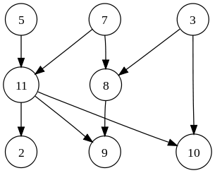
Kahn’s algorithm
Kahn’s algorithm
Compute the degree, Visited=0
S=vertices with zero in degree
While S not empty
Remove a vertex u from S
Visited++
for each v neighbor of u
v.indegree—
If(v.indegree==0) S.add(v)
If(visited==|V|)
No cycle
Else
cycle

Slide 26
Kahn’s algorithm
Kahn’s algorithm
Compute the degree, Visited=0
S=vertices with zero in degree
While S not empty
Remove a vertex u from S
Visited++
for each v neighbor of u
v.indegree—
If(v.indegree==0) S.add(v)
 | 2 | 3 | 5 | 7 | 8 | 9 | 10 | 11
2
3 |  |  |  |  | 1 |  | 1
5 |  |  |  |  |  |  |  | 1
7 |  |  |  |  | 1 |  |  | 1
8 |  |  |  |  |  | 1
9
10
11 | 1 |  |  |  |  | 1 | 1

Slide 27
Kahn’s algorithm
Kahn’s algorithm
Compute the degree, Visited=0
S=vertices with zero in degree
While S not empty
Remove a vertex u from S
Visited++
for each v neighbor of u
v.indegree—
If(v.indegree==0) S.add(v)
V | In
2 | 1
3 | 0
5 | 0
7 | 0
8 | 2
9 | 2
10 | 2
11 | 2
 | 2 | 3 | 5 | 7 | 8 | 9 | 10 | 11
2
3 |  |  |  |  | 1 |  | 1
5 |  |  |  |  |  |  |  | 1
7 |  |  |  |  | 1 |  |  | 1
8 |  |  |  |  |  | 1
9
10
11 | 1 |  |  |  |  | 1 | 1

Slide 28
Kahn’s algorithm
Kahn’s algorithm
Compute the degree, Visited=0
S={3,5,7}
While S not empty
Remove a vertex u from S
Visited++
for each v neighbor of u
v.indegree—
If(v.indegree==0) S.add(v)
V | In
2 | 1
3 | 0
5 | 0
7 | 0
8 | 2
9 | 2
10 | 2
11 | 2
 | 2 | 3 | 5 | 7 | 8 | 9 | 10 | 11
2
3 |  |  |  |  | 1 |  | 1
5 |  |  |  |  |  |  |  | 1
7 |  |  |  |  | 1 |  |  | 1
8 |  |  |  |  |  | 1
9
10
11 | 1 |  |  |  |  | 1 | 1

Slide 29
Kahn’s algorithm
Kahn’s algorithm
Compute the degree, Visited=0
S={5,7}
While S not empty
Remove a vertex u from S//u=3
Visited++//1
for each v neighbor of u//8,10
v.indegree—
If(v.indegree==0) S.add(v)
V | In
2 | 1
3 | 0
5 | 0
7 | 0
8 | 2
9 | 2
10 | 2
11 | 2
 | 2 | 3 | 5 | 7 | 8 | 9 | 10 | 11
2
3 |  |  |  |  | 1 |  | 1
5 |  |  |  |  |  |  |  | 1
7 |  |  |  |  | 1 |  |  | 1
8 |  |  |  |  |  | 1
9
10
11 | 1 |  |  |  |  | 1 | 1

Slide 30
Kahn’s algorithm
Kahn’s algorithm
Compute the degree, Visited=0
S={5,7}
While S not empty
Remove a vertex u from S//u=3
Visited++//1
for each v neighbor of u//8,10
v.indegree—
If(v.indegree==0) S.add(v)
V | In
2 | 1
3 | 0
5 | 0
7 | 0
8 | 1
9 | 2
10 | 1
11 | 2
 | 2 | 3 | 5 | 7 | 8 | 9 | 10 | 11
2
3 |  |  |  |  | 1 |  | 1
5 |  |  |  |  |  |  |  | 1
7 |  |  |  |  | 1 |  |  | 1
8 |  |  |  |  |  | 1
9
10
11 | 1 |  |  |  |  | 1 | 1

Slide 31
Kahn’s algorithm
Kahn’s algorithm
Compute the degree, Visited=0
S={5,7}
While S not empty
Remove a vertex u from S//u=3
Visited++
for each v neighbor of u
v.indegree—
If(v.indegree==0) S.add(v)
V | In
2 | 1
3 | 0
5 | 0
7 | 0
8 | 1
9 | 2
10 | 1
11 | 2
 | 2 | 3 | 5 | 7 | 8 | 9 | 10 | 11
2
3 |  |  |  |  | 1 |  | 1
5 |  |  |  |  |  |  |  | 1
7 |  |  |  |  | 1 |  |  | 1
8 |  |  |  |  |  | 1
9
10
11 | 1 |  |  |  |  | 1 | 1

Slide 32
Kahn’s algorithm
Kahn’s algorithm
Compute the degree, Visited=0
S={7}
While S not empty
Remove a vertex u from S//u=5
Visited++//2
for each v neighbor of u//11
v.indegree—
If(v.indegree==0) S.add(v)
V | In
2 | 1
3 | 0
5 | 0
7 | 0
8 | 1
9 | 2
10 | 1
11 | 2
 | 2 | 3 | 5 | 7 | 8 | 9 | 10 | 11
2
3 |  |  |  |  | 1 |  | 1
5 |  |  |  |  |  |  |  | 1
7 |  |  |  |  | 1 |  |  | 1
8 |  |  |  |  |  | 1
9
10
11 | 1 |  |  |  |  | 1 | 1

Slide 33
Kahn’s algorithm
Kahn’s algorithm
Compute the degree, Visited=0
S={7}
While S not empty
Remove a vertex u from S//u=5
Visited++//2
for each v neighbor of u//11
v.indegree—
If(v.indegree==0) S.add(v)
V | In
2 | 1
3 | 0
5 | 0
7 | 0
8 | 1
9 | 2
10 | 1
11 | 1
 | 2 | 3 | 5 | 7 | 8 | 9 | 10 | 11
2
3 |  |  |  |  | 1 |  | 1
5 |  |  |  |  |  |  |  | 1
7 |  |  |  |  | 1 |  |  | 1
8 |  |  |  |  |  | 1
9
10
11 | 1 |  |  |  |  | 1 | 1

Slide 34
Kahn’s algorithm
Kahn’s algorithm
Compute the degree, Visited=0
S={7}
While S not empty
Remove a vertex u from S//u=5
Visited++//2
for each v neighbor of u//11
v.indegree—
If(v.indegree==0) S.add(v)
V | In
2 | 1
3 | 0
5 | 0
7 | 0
8 | 1
9 | 2
10 | 1
11 | 1
 | 2 | 3 | 5 | 7 | 8 | 9 | 10 | 11
2
3 |  |  |  |  | 1 |  | 1
5 |  |  |  |  |  |  |  | 1
7 |  |  |  |  | 1 |  |  | 1
8 |  |  |  |  |  | 1
9
10
11 | 1 |  |  |  |  | 1 | 1

Slide 35
Kahn’s algorithm
Kahn’s algorithm
Compute the degree, Visited=0
S={}
While S not empty
Remove a vertex u from S//u=7
Visited++//3
for each v neighbor of u//8,11
v.indegree—
If(v.indegree==0) S.add(v)
V | In
2 | 1
3 | 0
5 | 0
7 | 0
8 | 1
9 | 2
10 | 1
11 | 1
 | 2 | 3 | 5 | 7 | 8 | 9 | 10 | 11
2
3 |  |  |  |  | 1 |  | 1
5 |  |  |  |  |  |  |  | 1
7 |  |  |  |  | 1 |  |  | 1
8 |  |  |  |  |  | 1
9
10
11 | 1 |  |  |  |  | 1 | 1

Slide 36
Kahn’s algorithm
Kahn’s algorithm
Compute the degree, Visited=0
S={}
While S not empty
Remove a vertex u from S//u=7
Visited++//3
for each v neighbor of u//8,11
v.indegree—
If(v.indegree==0) S.add(v)
V | In
2 | 1
3 | 0
5 | 0
7 | 0
8 | 0
9 | 2
10 | 1
11 | 0
 | 2 | 3 | 5 | 7 | 8 | 9 | 10 | 11
2
3 |  |  |  |  | 1 |  | 1
5 |  |  |  |  |  |  |  | 1
7 |  |  |  |  | 1 |  |  | 1
8 |  |  |  |  |  | 1
9
10
11 | 1 |  |  |  |  | 1 | 1

Slide 37
Kahn’s algorithm
Kahn’s algorithm
Compute the degree, Visited=0
S={8,11}
While S not empty
Remove a vertex u from S//u=7
Visited++//3
for each v neighbor of u//8,11
v.indegree—
If(v.indegree==0) S.add(v)
V | In
2 | 1
3 | 0
5 | 0
7 | 0
8 | 0
9 | 2
10 | 1
11 | 0
 | 2 | 3 | 5 | 7 | 8 | 9 | 10 | 11
2
3 |  |  |  |  | 1 |  | 1
5 |  |  |  |  |  |  |  | 1
7 |  |  |  |  | 1 |  |  | 1
8 |  |  |  |  |  | 1
9
10
11 | 1 |  |  |  |  | 1 | 1

Slide 38
Kahn’s algorithm
Kahn’s algorithm
Compute the degree, Visited=0
S={11}
While S not empty
Remove a vertex u from S//u=8
Visited++//4
for each v neighbor of u//9
v.indegree—
If(v.indegree==0) S.add(v)
V | In
2 | 1
3 | 0
5 | 0
7 | 0
8 | 0
9 | 2
10 | 1
11 | 0
 | 2 | 3 | 5 | 7 | 8 | 9 | 10 | 11
2
3 |  |  |  |  | 1 |  | 1
5 |  |  |  |  |  |  |  | 1
7 |  |  |  |  | 1 |  |  | 1
8 |  |  |  |  |  | 1
9
10
11 | 1 |  |  |  |  | 1 | 1

Slide 39
Kahn’s algorithm
Kahn’s algorithm
Compute the degree, Visited=0
S={11}
While S not empty
Remove a vertex u from S//u=8
Visited++//4
for each v neighbor of u//9
v.indegree—
If(v.indegree==0) S.add(v)
V | In
2 | 1
3 | 0
5 | 0
7 | 0
8 | 0
9 | 1
10 | 1
11 | 0
 | 2 | 3 | 5 | 7 | 8 | 9 | 10 | 11
2
3 |  |  |  |  | 1 |  | 1
5 |  |  |  |  |  |  |  | 1
7 |  |  |  |  | 1 |  |  | 1
8 |  |  |  |  |  | 1
9
10
11 | 1 |  |  |  |  | 1 | 1

Slide 40
Kahn’s algorithm
Kahn’s algorithm
Compute the degree, Visited=0
S={11}
While S not empty
Remove a vertex u from S//u=8
Visited++//4
for each v neighbor of u//9
v.indegree—
If(v.indegree==0) S.add(v)
V | In
2 | 1
3 | 0
5 | 0
7 | 0
8 | 0
9 | 1
10 | 1
11 | 0
 | 2 | 3 | 5 | 7 | 8 | 9 | 10 | 11
2
3 |  |  |  |  | 1 |  | 1
5 |  |  |  |  |  |  |  | 1
7 |  |  |  |  | 1 |  |  | 1
8 |  |  |  |  |  | 1
9
10
11 | 1 |  |  |  |  | 1 | 1

Slide 41
Kahn’s algorithm
Kahn’s algorithm
Compute the degree, Visited=0
S={}
While S not empty
Remove a vertex u from S//u=11
Visited++//5
for each v neighbor of u//2,9,10
v.indegree—
If(v.indegree==0) S.add(v)
V | In
2 | 1
3 | 0
5 | 0
7 | 0
8 | 0
9 | 1
10 | 1
11 | 0
 | 2 | 3 | 5 | 7 | 8 | 9 | 10 | 11
2
3 |  |  |  |  | 1 |  | 1
5 |  |  |  |  |  |  |  | 1
7 |  |  |  |  | 1 |  |  | 1
8 |  |  |  |  |  | 1
9
10
11 | 1 |  |  |  |  | 1 | 1

Slide 42
Kahn’s algorithm
Kahn’s algorithm
Compute the degree, Visited=0
S={}
While S not empty
Remove a vertex u from S//u=11
Visited++//5
for each v neighbor of u//2,9,10
v.indegree—
If(v.indegree==0) S.add(v)
V | In
2 | 0
3 | 0
5 | 0
7 | 0
8 | 0
9 | 0
10 | 0
11 | 0
 | 2 | 3 | 5 | 7 | 8 | 9 | 10 | 11
2
3 |  |  |  |  | 1 |  | 1
5 |  |  |  |  |  |  |  | 1
7 |  |  |  |  | 1 |  |  | 1
8 |  |  |  |  |  | 1
9
10
11 | 1 |  |  |  |  | 1 | 1

Slide 43
Kahn’s algorithm
Kahn’s algorithm
Compute the degree, Visited=0
S={2,9,10}
While S not empty
Remove a vertex u from S//u=11
Visited++//5
for each v neighbor of u//2,9,10
v.indegree—
If(v.indegree==0) S.add(v)
V | In
2 | 0
3 | 0
5 | 0
7 | 0
8 | 0
9 | 0
10 | 0
11 | 0
 | 2 | 3 | 5 | 7 | 8 | 9 | 10 | 11
2
3 |  |  |  |  | 1 |  | 1
5 |  |  |  |  |  |  |  | 1
7 |  |  |  |  | 1 |  |  | 1
8 |  |  |  |  |  | 1
9
10
11 | 1 |  |  |  |  | 1 | 1

Slide 44
Kahn’s algorithm
Kahn’s algorithm
Compute the degree, Visited=0
S={9,10}
While S not empty
Remove a vertex u from S//u=2
Visited++//6
for each v neighbor of u
v.indegree—
If(v.indegree==0) S.add(v)
V | In
2 | 0
3 | 0
5 | 0
7 | 0
8 | 0
9 | 0
10 | 0
11 | 0
 | 2 | 3 | 5 | 7 | 8 | 9 | 10 | 11
2
3 |  |  |  |  | 1 |  | 1
5 |  |  |  |  |  |  |  | 1
7 |  |  |  |  | 1 |  |  | 1
8 |  |  |  |  |  | 1
9
10
11 | 1 |  |  |  |  | 1 | 1

Slide 45
Kahn’s algorithm
Kahn’s algorithm
Compute the degree, Visited=0
S={10}
While S not empty
Remove a vertex u from S//u=9
Visited++//7
for each v neighbor of u
v.indegree—
If(v.indegree==0) S.add(v)
V | In
2 | 0
3 | 0
5 | 0
7 | 0
8 | 0
9 | 0
10 | 0
11 | 0
 | 2 | 3 | 5 | 7 | 8 | 9 | 10 | 11
2
3 |  |  |  |  | 1 |  | 1
5 |  |  |  |  |  |  |  | 1
7 |  |  |  |  | 1 |  |  | 1
8 |  |  |  |  |  | 1
9
10
11 | 1 |  |  |  |  | 1 | 1

Slide 46
Kahn’s algorithm
Kahn’s algorithm
Compute the degree, Visited=0
S={}
While S not empty
Remove a vertex u from S//u=10
Visited++//8
for each v neighbor of u
v.indegree—
If(v.indegree==0) S.add(v)
V | In
2 | 0
3 | 0
5 | 0
7 | 0
8 | 0
9 | 0
10 | 0
11 | 0
 | 2 | 3 | 5 | 7 | 8 | 9 | 10 | 11
2
3 |  |  |  |  | 1 |  | 1
5 |  |  |  |  |  |  |  | 1
7 |  |  |  |  | 1 |  |  | 1
8 |  |  |  |  |  | 1
9
10
11 | 1 |  |  |  |  | 1 | 1

Slide 47
Kahn’s algorithm
If(visited==|V|)
No cycle
Else
cycle
Visited=8
|V|=8
DAG
 | 2 | 3 | 5 | 7 | 8 | 9 | 10 | 11
2
3 |  |  |  |  | 1 |  | 1
5 |  |  |  |  |  |  |  | 1
7 |  |  |  |  | 1 |  |  | 1
8 |  |  |  |  |  | 1
9
10
11 | 1 |  |  |  |  | 1 | 1

Slide 48
Kahn’s algorithm
Kahn’sAlgorithm:
ComputeIndegree()
visited=0
S=vertices with zero in degree
While S not empty
Remove vertex u from S (u=S.dequeuer())
visited++
for each v neighbor of u
v.indegree—
If(v.indegree==0) S.add(v)
If(visited==|V|): No cycle
Else: Cycle
ComputeIndegree {
foreach node n in nodes
indegree[n]=0
}
foreach node e=(u,v) in edges
indegree[v]++
}

Slide 49
Single Source Shortest path algorithms

Slide 50
Single-source shortest-path problem
There are multiple paths from a source vertex to a destination vertex
Shortest path: the path whose total weight (i.e., sum of edge weights) is minimum
Examples:
Austin->Houston->Atlanta->Washington: 1560 miles
Austin->Dallas->Denver->Atlanta->Washington: 2980 miles

Slide 51
Single-source shortest-path problem (cont.)
Common algorithms: Dijkstra's algorithm, Bellman-Ford algorithm
BFS can be used to solve the shortest graph problem when the graph is weightless or all the weights are the same
(mark vertices before Enqueue)

Slide 52
The Bellman-Ford Algorithm
Bellman-Ford(G, w, s)
Initialize-Single-Source(G, s)
for i := 1 to |V| - 1 do
for each edge (u, v) ∈ E do
Relax(u, v, w)
for each vertex v ∈ u.adj do
if d[v] > d[u] + w(u, v)
then return False // there is a negative cycle
return True
Relax(u, v, w)
if d[v] > d[u] + w(u, v)
then d[v] := d[u] + w(u, v)
parent[v] := u

Slide 53
Bellman-Ford Algorithm Example
t
5
x
-2
6
∞
∞
-3
s
0
8
-4
7
2
7
∞
∞
9
y
z

Slide 54
Bellman-Ford Algorithm Example
t
5
x
6
-2
∞
6
-3
s
0
8
-4
7
2
7
7
∞
9
y
z

Slide 55
Bellman-Ford Algorithm Example
t
5
x
-2
6
6
4
-3
s
0
8
-4
7
2
7
7
2
9
y
z

Slide 56
Bellman-Ford Algorithm Example
t
5
x
-2
6
2
4
-3
s
0
8
-4
7
2
7
7
2
9
y
z

Slide 57
Bellman-Ford Algorithm Example
t
5
x
-2
6
2
4
-3
s
0
8
-4
7
2
7
7
−2
9
y
z

Slide 58
The Bellman-Ford Algorithm
t
x
t
x
5
5
∞,nil
∞,nil
6,s
∞,nil
6
-2
6
-2
-3
-3
0
8
0
8
s
-4
7
s
-4
7
2
2
7
7
∞,nil
∞,nil
7,s
∞,nil
9
9
y
Initialization
z
y
After pass 1
z
t
x
t
x
5
5
6,s
4,y
2,x
4,y
6
-2
6
-2
-3
-3
0
8
0
8
s
-4
7
s
-4
7
2
2
7
7
7,s
2,t
7,s
2,t
9
9
y
After pass 2
z
y
After pass 3
z
The order of edges examined in each pass: (t, x), (t, z), (x, t), (y, x), (y, t), (y, z), (z, x), (z, s), (s, t), (s, y)

Slide 59
The Bellman-Ford Algorithm
t
x
5
2,x
4,y
6
-2
-3
0
8
s
-4
7
2
7
7,s
-2,t
9
y
z
After pass 4
The order of edges examined in each pass: (t, x), (t, z), (x, t), (y, x), (y, t), (y, z), (z, x), (z, s), (s, t), (s, y)

Slide 60
Time Complexity
Bellman-Ford(G, w, s)
Initialize-Single-Source(G, s)
for i := 1 to |V| - 1 do
for each edge (u, v) ∈ E do
Relax(u, v, w)
for each vertex v ∈ u.adj do
if d[v] > d[u] + w(u, v)
then return False // there is a negative cycle
return True
Time complexity: O(|V||E|)

Slide 61
Dijkstra’s Algorithm For Shortest Paths
DIJKSTRA(G, s)
INIT(G, s)
S←Ø > set of discovered nodes
Q←V[G]
while Q ≠Ø do
u←EXTRACT-MIN(Q)
S←S U {u}
for each v Î Adj[u] do
RELAX(u, v) > May cause
> DECREASE-KEY(Q, v, d[v])

Slide 62
Dijkstra’s Algorithm Example
u
v
∞
1
∞
10
0
2
3
9
s
4
6
7
5
∞
∞
2
x
y

Slide 63
Dijkstra’s Algorithm Example
u
v
10
1
∞
10
9
0
2
3
s
4
6
7
5
5
∞
2
x
y

Slide 64
Dijkstra’s Algorithm Example
u
v
8
1
14
10
0
2
3
9
s
4
6
7
5
5
7
2
x
y

Slide 65
Dijkstra’s Algorithm Example
u
v
8
1
13
10
2
3
9
s
0
4
6
7
5
5
7
2
x
y

Slide 66
Dijkstra’s Algorithm Example
u
v
8
1
9
10
0
2
3
9
s
4
6
7
5
5
7
2
x
y

Slide 67
Dijkstra’s Algorithm Example
u
v
8
1
9
10
2
3
9
0
4
6
s
7
5
5
7
2
x
y

Slide 68
All Pair Shortest Path
Floyd-Warshall Algorithm

Slide 69
All-Pairs Shortest Path Problem
Suppose we are given a directed graph G=(V,E) and a weight function w: E->R.
We assume that G does not contain cycles of weight 0 or less.
The All-Pairs Shortest Path Problem asks to find the length of the shortest path between any pair of vertices in G.

Slide 70
Quick Solutions
If the weight function is nonnegative for all edges, then we can use Dijkstra’s single source shortest path algorithm for all vertices to solve the problem.
This yields an O(n³) algorithm on graphs with n vertices (on dense graphs and with a simple implementation).

Slide 71
Quick Solution
For arbitrary weight functions, we can use the Bellman-Ford algorithm applied to all vertices. This yields an O(n⁴) algorithm for graphs with n vertices.

Slide 72
Floyd-Warshall
We will now investigate a dynamic programming solution that solved the problem in O(n³) time for a graph with n vertices.
This algorithm is known as the Floyd-Warshall algorithm, but it was apparently described earlier by Roy.

Slide 73
Representation of the Input
We assume that the input is represented by a weight matrix W= (w_{ij})_{i,j in E} that is defined by
w_{ij}= 0 if i=j
w_{ij}= w(i,j) if i≠j and (i,j) in E
w_{ij}= ∞ if i≠j and (i,j) not in E

Slide 74
Format of the Output
If the graph has n vertices, we return a distance matrix (d_{ij}), where d_{ij} the length of the path from i to j.

Slide 75
Intermediate Vertices
Without loss of generality, we will assume that V={1,2,…,n}, i.e., that the vertices of the graph are numbered from 1 to n.
Given a path p=(v₁, v₂,…, v_{m}) in the graph, we will call the vertices v_{k} with index k in {2,…,m-1} the intermediate vertices of p.

Slide 76
Key Definition
The key to the Floyd-Warshall algorithm is the following definition:
Let d_{ij}^{(k)} denote the length of the shortest path from i to j such that all intermediate vertices are contained in the set {1,…,k}.

Slide 77
Remark 1
A shortest path does not contain any vertex twice, as this would imply that the path contains a cycle. By assumption, cycles in the graph have a positive weight, so removing the cycle would result in a shorter path, which is impossible.

Slide 78
The structure of a shortest path:
We use a different characterization of the structure of a shortest path than we used in the matrix-multiplication-based all-pairs algorithms.
The algorithm considers the “intermediate” vertices of a shortest path, where an intermediate vertex of a simple path p=<v₁,v₂,…,v_{l}> is any vertex in p other than v₁ or v_{l}, that is, any vertex in the set {v₂,v₃,…,v_{l-1}}

Slide 79
Remark 2
Consider a shortest path p from i to j such that the intermediate vertices are from the set {1,…,k}.
If the vertex k is not an intermediate vertex on p, then d_{ij}^{(k)} = d_{ij}^{(k-1)}
If the vertex k is an intermediate vertex on p, then d_{ij}^{(k)} = d_{ik}^{(k-1)} + d_{kj}^{(k-1)}
Interestingly, in either case, the subpaths contain merely nodes from {1,…,k-1}.

Slide 80
Remark 2
Therefore, we can conclude that
d_{ij}^{(k)} = min{d_{ij}^{(k-1)} , d_{ik}^{(k-1)} + d_{kj}^{(k-1)}}

Slide 81
Recursive Formulation
If we do not use intermediate nodes, i.e., when k=0, then
d_{ij}⁽⁰⁾ = w_{ij}
If k>0, then
d_{ij}^{(k)} = min{d_{ij}^{(k-1)} , d_{ik}^{(k-1)} + d_{kj}^{(k-1)}}

Slide 82
Floyd Warshall Algorithm
Let’s go over the premise of how Floyd-Warshall algorithm works…
Let the vertices in a graph be numbered from 1 … n.
Consider the subset {1,2,…, k} of these n vertices.
Imagine finding the shortest path from vertex i to vertex j that uses vertices in the set {1,2,…,k} only.
There are two situations:
k is an intermediate vertex on the shortest path.
k is not an intermediate vertex on the shortest path.
k
i
j

Slide 83
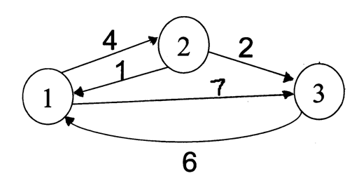
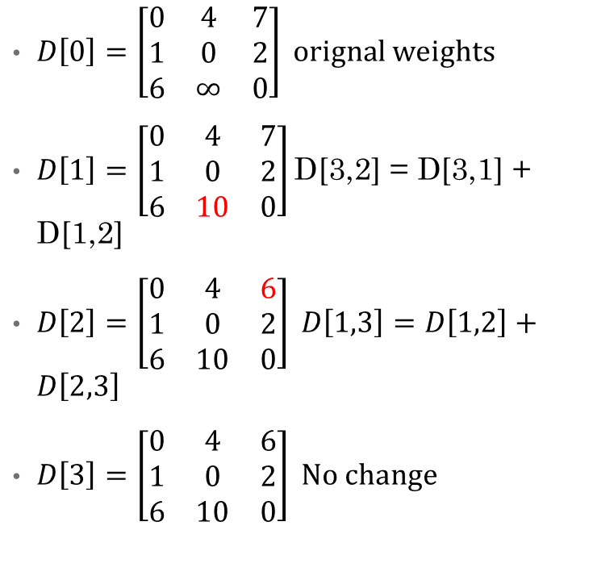
Floyd Warshall Algorithm - Example
$D\left[0\right]=\left[\begin{matrix}0 & 4 & 7 \\ 1 & 0 & 2 \\ 6 & ∞ & 0\end{matrix}\right] orignal weights$
$D\left[1\right]=\left[\begin{matrix}0 & 4 & 7 \\ 1 & 0 & 2 \\ 6 & 10 & 0\end{matrix}\right]\text{D}\text{[3,2] = }\text{D}\text{[3,1] + }\text{D}\text{[1,2]}$
$D\left[2\right]=\left[\begin{matrix}0 & 4 & 6 \\ 1 & 0 & 2 \\ 6 & 10 & 0\end{matrix}\right] D\left[1,3\right]=D\left[1,2\right]+D\left[2,3\right]$
$D\left[3\right]=\left[\begin{matrix}0 & 4 & 6 \\ 1 & 0 & 2 \\ 6 & 10 & 0\end{matrix}\right] No change$

Slide 84
Floyd-Warshall Algorithm
Floyd-Warshall(W)
n = Number of rows of W;
D⁽⁰⁾ = W;
for k = 1 to n do
for i = 1 to n do
for j = 1 to n do
d_{ij}^{(k)} = min{d_{ij}^{(k-1)} , d_{ik}^{(k-1)} + d_{kj}^{(k-1)}};
end;
end;
end;
return D^{(n)};

Slide 85

Floyd-Warshall Algorithm (Version 2)
Looking at this example, we can come up with the following algorithm:
Let D store the matrix with the initial graph edge information initially, and update D with the calculated shortest paths.
The final D matrix will store all the shortest paths.
$for k=1→n$
$for i=1→n$
$for j=1→n$
$D\left[i,j\right]=min⁡(D\left[i,j\right],D\left[i,k\right]+D[k,j])$

Slide 86
Time and Space Requirements
The running time is obviously O(n³).
However, in this version, the space requirements are high. One can reduce the space from O(n³) to O(n²) by using a single array d.

Slide 87
Example
2
4
3
1
3
8
1
-4
-5
7
2
5
4
6

Slide 88
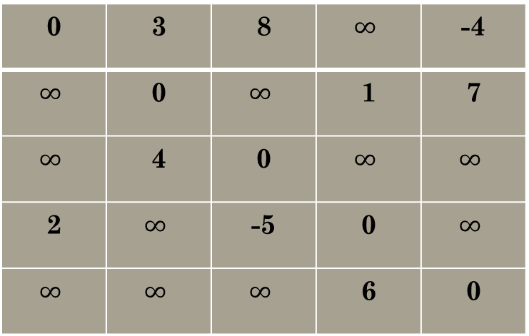
Example D[0]
2
0 | 3 | 8 | $$∞$$ | -4
$$∞$$ | 0 | $$∞$$ | 1 | 7
$$∞$$ | 4 | 0 | $$∞$$ | $$∞$$
2 | $$∞$$ | -5 | 0 | $$∞$$
$$∞$$ | $$∞$$ | $$∞$$ | 6 | 0
4
3
1
3
8
1
-4
-5
7
2
5
4
6

Slide 89
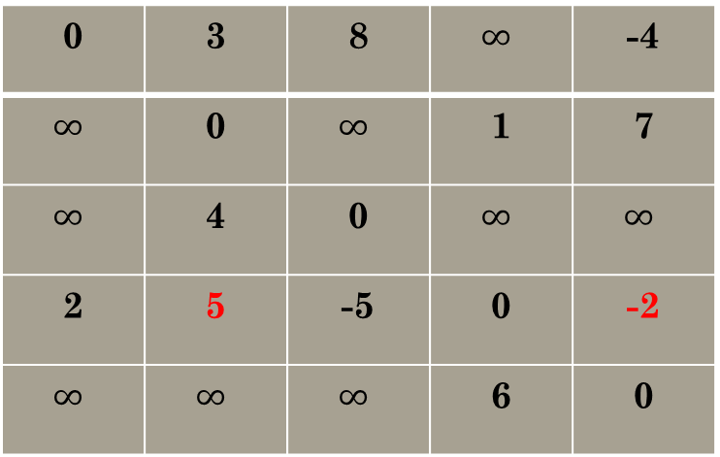
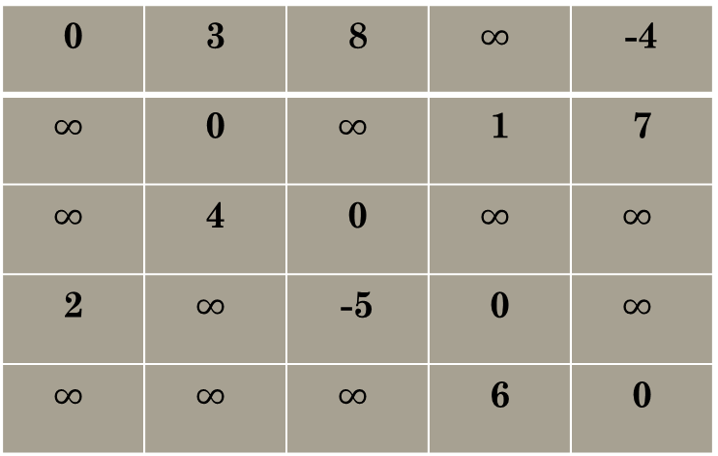
Example D[0],D[1]
0 | 3 | 8 | $$∞$$ | -4
$$∞$$ | 0 | $$∞$$ | 1 | 7
$$∞$$ | 4 | 0 | $$∞$$ | $$∞$$
2 | $$∞$$ | -5 | 0 | $$∞$$
$$∞$$ | $$∞$$ | $$∞$$ | 6 | 0
0 | 3 | 8 | $$∞$$ | -4
$$∞$$ | 0 | $$∞$$ | 1 | 7
$$∞$$ | 4 | 0 | $$∞$$ | $$∞$$
2 | 5 | -5 | 0 | -2
$$∞$$ | $$∞$$ | $$∞$$ | 6 | 0

Slide 90
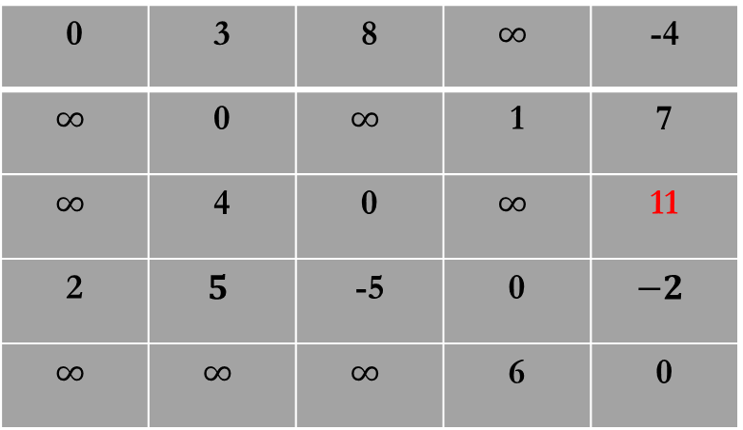
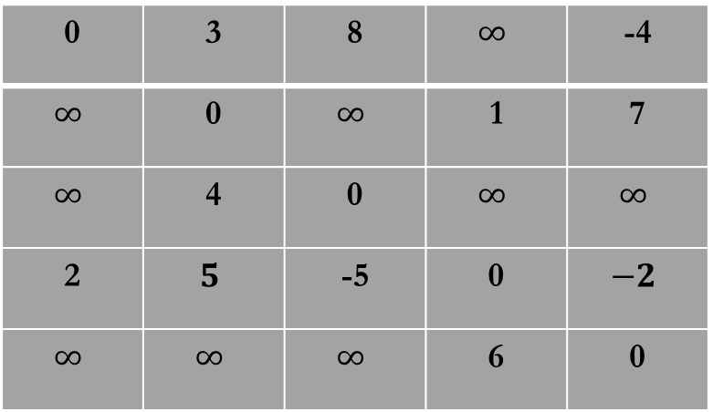
Example D[1],D[2]
0 | 3 | 8 | $$∞$$ | -4
$$∞$$ | 0 | $$∞$$ | 1 | 7
$$∞$$ | 4 | 0 | $$∞$$ | $$∞$$
2 | $$5$$ | -5 | 0 | $$−2$$
$$∞$$ | $$∞$$ | $$∞$$ | 6 | 0
0 | 3 | 8 | $$∞$$ | -4
$$∞$$ | 0 | $$∞$$ | 1 | 7
$$∞$$ | 4 | 0 | $$∞$$ | 11
2 | $$5$$ | -5 | 0 | $$−2$$
$$∞$$ | $$∞$$ | $$∞$$ | 6 | 0

Slide 91
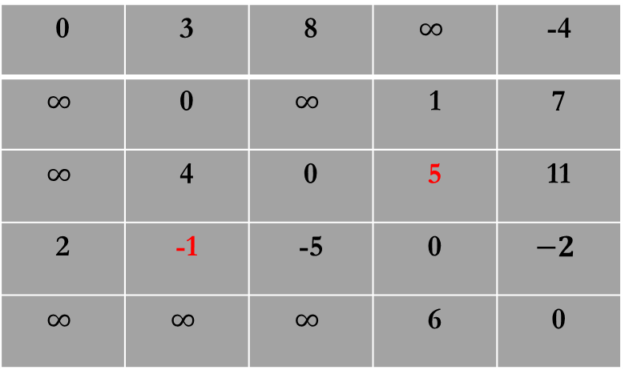
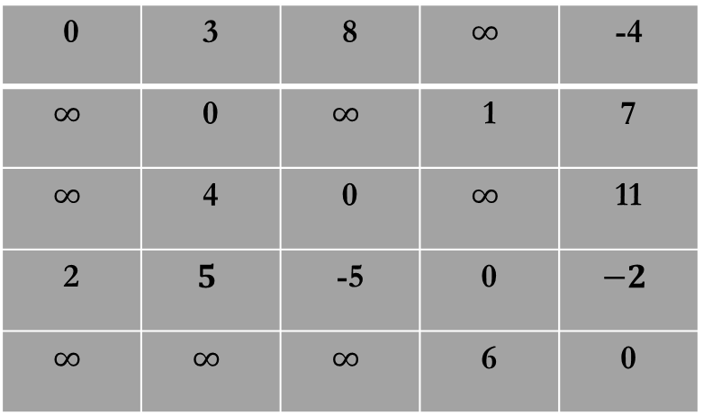
Example D[2],D[3]
0 | 3 | 8 | $$∞$$ | -4
$$∞$$ | 0 | $$∞$$ | 1 | 7
$$∞$$ | 4 | 0 | $$∞$$ | 11
2 | $$5$$ | -5 | 0 | $$−2$$
$$∞$$ | $$∞$$ | $$∞$$ | 6 | 0
0 | 3 | 8 | $$∞$$ | -4
$$∞$$ | 0 | $$∞$$ | 1 | 7
$$∞$$ | 4 | 0 | 5 | 11
2 | -1 | -5 | 0 | $$−2$$
$$∞$$ | $$∞$$ | $$∞$$ | 6 | 0

Slide 92
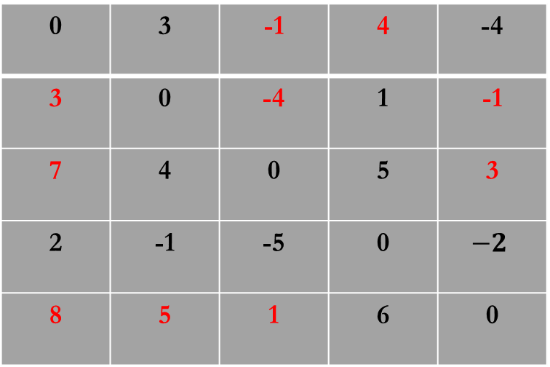
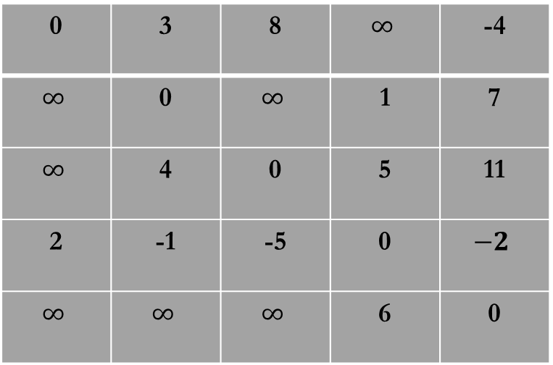
Example D[3],D[4]
0 | 3 | 8 | $$∞$$ | -4
$$∞$$ | 0 | $$∞$$ | 1 | 7
$$∞$$ | 4 | 0 | 5 | 11
2 | -1 | -5 | 0 | $$−2$$
$$∞$$ | $$∞$$ | $$∞$$ | 6 | 0
0 | 3 | -1 | 4 | -4
3 | 0 | -4 | 1 | -1
7 | 4 | 0 | 5 | 3
2 | -1 | -5 | 0 | $$−2$$
8 | 5 | 1 | 6 | 0

Slide 93
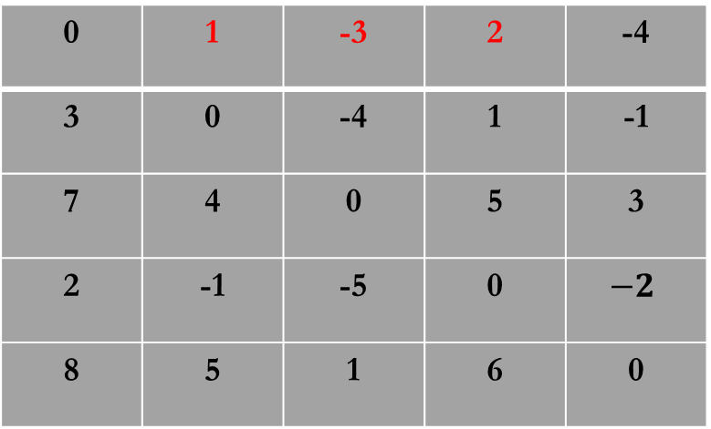
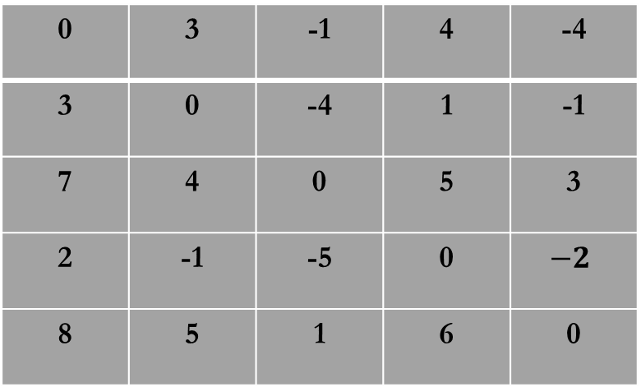
Example D[4],D[5]
0 | 3 | -1 | 4 | -4
3 | 0 | -4 | 1 | -1
7 | 4 | 0 | 5 | 3
2 | -1 | -5 | 0 | $$−2$$
8 | 5 | 1 | 6 | 0
0 | 1 | -3 | 2 | -4
3 | 0 | -4 | 1 | -1
7 | 4 | 0 | 5 | 3
2 | -1 | -5 | 0 | $$−2$$
8 | 5 | 1 | 6 | 0

Slide 94
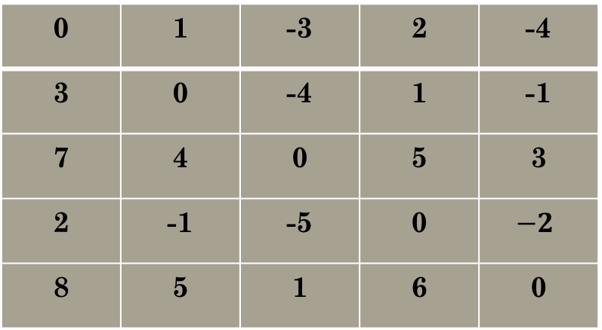
Example
2
4
3
0 | 1 | -3 | 2 | -4
3 | 0 | -4 | 1 | -1
7 | 4 | 0 | 5 | 3
2 | -1 | -5 | 0 | $$−2$$
8 | 5 | 1 | 6 | 0
1
3
8
1
-4
-5
7
2
5
4
6

